Slide 1


InsurAI
Intelligent insurance management system
presented by :
SANCHITA KUMARI
Intern at Infosys Springboard

Slide 2

Project Overview
InsurAI is a full stack web application designed to streamline and simplify insurance management.
Core Function: It provides a unified digital platform connecting:
Insurance Agents
Policyholders (Users)
Admins
Primary Goal: To digitize and manage policy tracking, approval workflows,and essential communication in a single, efficient system.

Slide 3
Problem statement
  Traditional insurance management is manual and time-consuming
  Agents struggle to manage clients efficiently.
  Policyholders face delays in approvals and updates. Admins lack a centralized system for monitoring.

Slide 4
Working of InsurAI
  User Registration & Login
Users and agents can register with role-based access.
  Dashboard
Admin sees all users, agents, and policies. Agents see assigned clients and policies.
Users can view their policies and approval status.

Slide 5
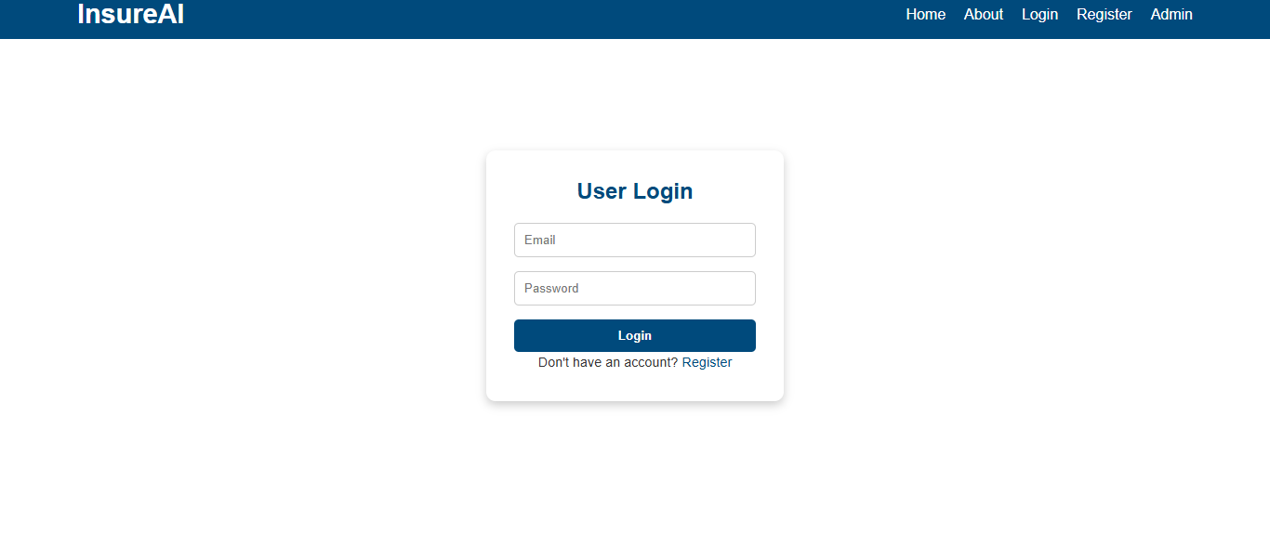
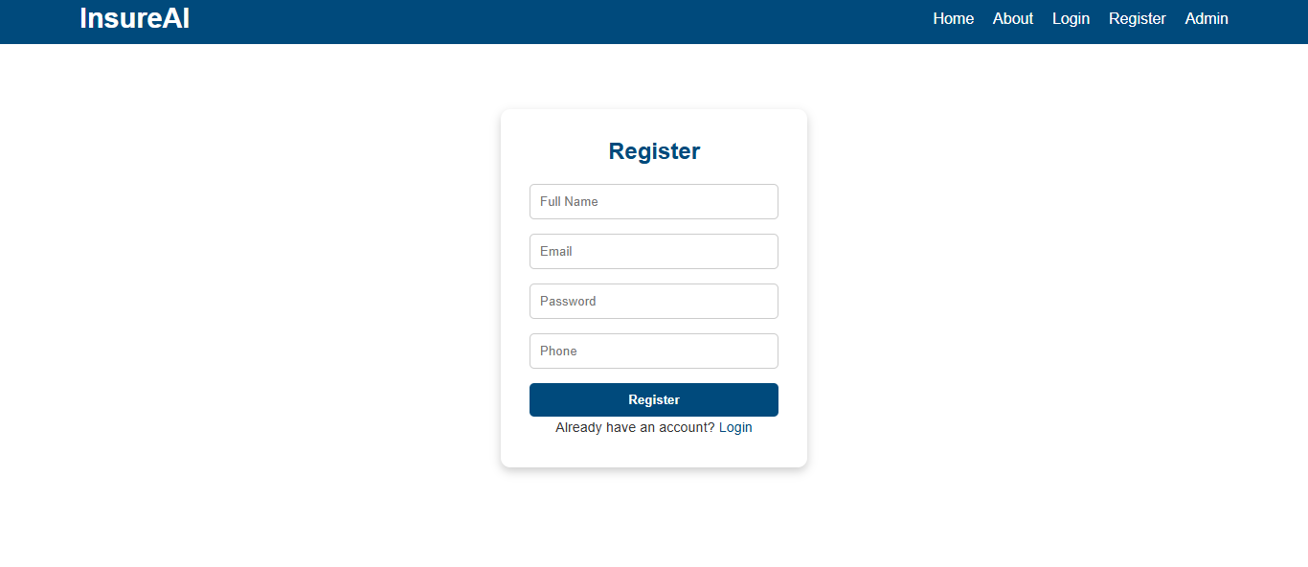

Slide 6
  Policy Management
Create, update, and track insurance policies
  Approval Workflow
Admin approves/rejects user requests.

Slide 7

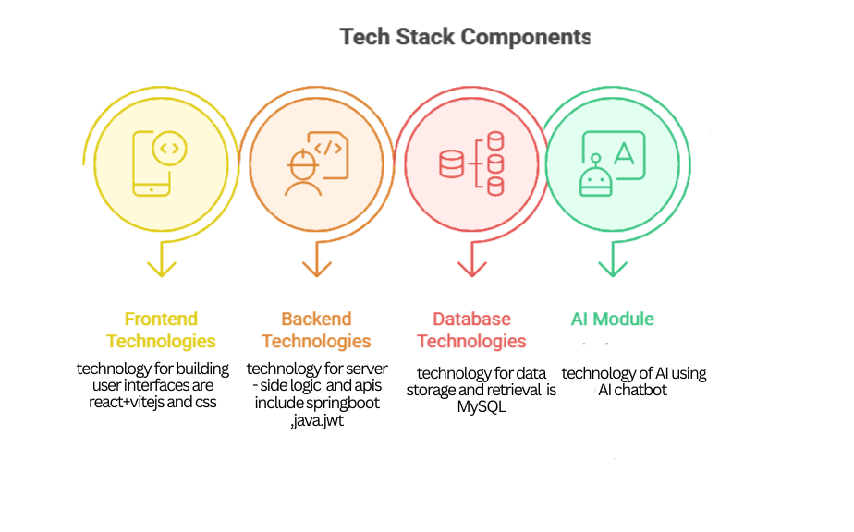
Technology stack
  Frontend: React (Vite)+CSS
  Backend: Spring Boot (Java)
  Database: MySQL
  API: RESTful endpoints
  Security: Role-based access
control

Slide 8
Features
  Role-based dashboards (Admin, Agent, User)
  Real-time policy tracking
  Simplified agent-client communication
  Admin control over approvals and reporting
  User-friendly interface

Slide 9


Future Scope
Integration with payment gateways for online premium payments
Mobile app development for on-the-go access
Al-driven policy recommendations for users
Analytics dashboard for agents and admins
Expansion to insurance claim management

Slide 10
Conclusion
  Insurai bridges the gap between agents and policyholders.
  Enhances efficiency, transparency, and user experience.
  Future improvements can make it a complete digital insurance ecosystem.

Slide 11
Thanking you

